Slide 1
GPU Accelerated Raster Based Polygon Packing
Spencer Gautreaux

Slide 2
Motivation
Develop an Efficient 2D Polygon Packing Algorithm
Get Hands On experience with GPU programming and algorithm design
(Abandoned) Distribute across multiple machines in a SaaS manner

Slide 3
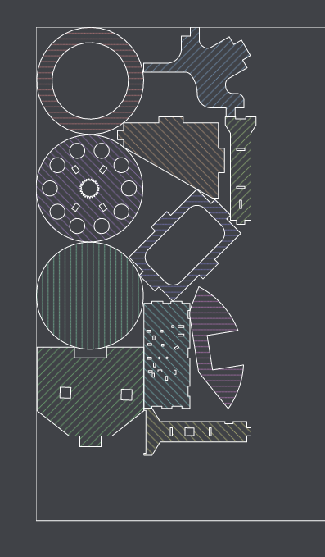
Output from Deepnest.io, Prioritizing material savings, 15s

Slide 4
Key Findings (Takeaways)
CPU Based Packing is pretty efficient
High Resolution rasters grow with O(bad)
GPU Programming is a infinite rabbit hole of nonsense
They can be really fast though

Slide 5
Workflow Discussion
Preprocessing - converting to our raster format
2D Bit Map
Packing - GPU based
Postprocessing - Manual Based

Slide 6
Preprocessing
Get a model in SVG format
Generate a corresponding raster image for the part

Slide 7
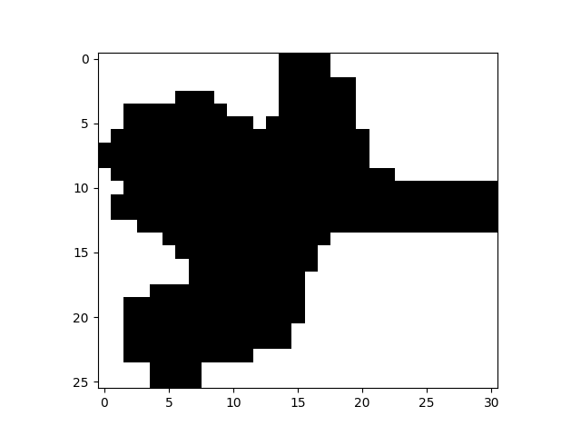

Preprocessing

Slide 8
Postprocessing
No need to post process when you segfault (almost) every time

Slide 9
GPU Introduction
SIMD
Warps, Blocks, Grids, and Kernels
Strided Memory
Inter-Block Synchronization

Slide 10
GPU Packing - Collision Detection
Sheet
Cycles
Part
Output
Grid Y
Each tread iterates entire part
O(bad)
Block X
Grid X

Slide 11
GPU Packing - Stride Reduce
Global Mem
Cycles

Slide 12
GPU Packing - Collision Detection
Sheet
Cycles
Part
Grid Y
Block X
Grid X

Slide 13
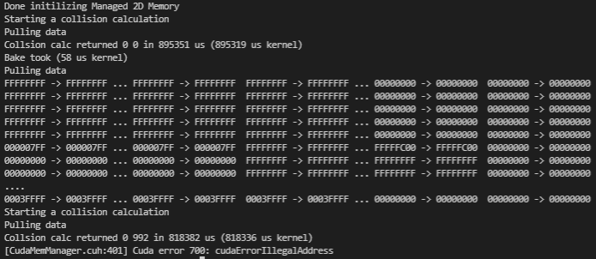
My Output

Slide 14
Summary
It shows promise
I really understand GPU programming now
Operating on a bitwise level might have been a mistake

Slide 15

Future Work
Device Primary Computation
Asynchronous from CPU
On-Device Reflections and Rotations
Dynamic Parallelism

Slide 16
Theoretical GPU Performance
Number Streaming Multiprocessors * # Resident Warps * 32 (Threads per warp) * 32 (Bits per integer)
GTX 1060: 1.966𝐸15 bit comparisons per second
GTX 3090: 1.505𝐸16 bit comparisons per second

Slide 17
Theoretical GPU Performance
SQ In Per Second
DPI | 300 | 600 | 1000 | 10000
GTX 1060 | 2.185E+10 | 5.461E+09 | 1.966E+09 | 1.966E+07
GTX 3090 | 1.672E+11 | 4.180E+10 | 1.505E+10 | 1.505E+08
Football fields per second
DPI | 300 | 600 | 1000 | 10000
1060 | 2.634E+03 | 6.584E+02 | 2.370E+02 | 2.370E+00
3090 | 2.016E+04 | 5.039E+03 | 1.814E+03 | 1.814E+01
* Ignoring any memory latency or buss collisions or scheduler overhead

Slide 18
Sheet
Part
Output

Slide 19
Sheet
Cycles
Part
Output
Grid Y
Block X
Grid X

Slide 20
Global Mem
Cycles

Slide 21
Sheet
Cycles
Part
Grid Y
Block X
Grid X

